Slide 1

Active Directory
Team Pi

Slide 2
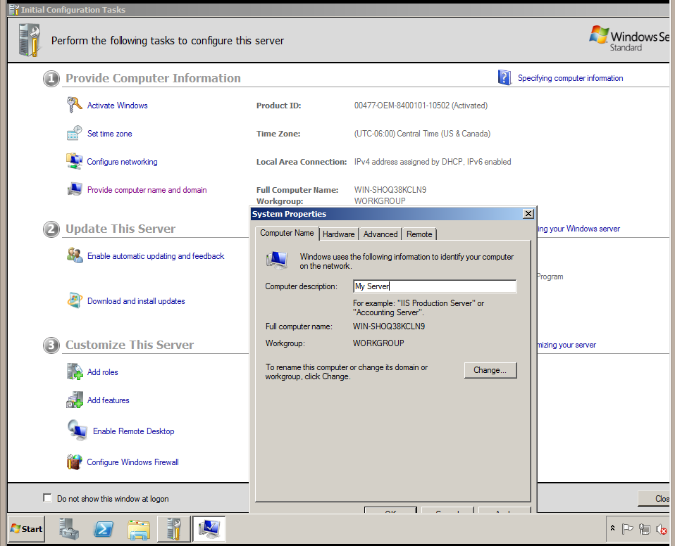
Change the Name of the Server
Click Provide Computer Name and Domain and input the name you want.

Slide 3
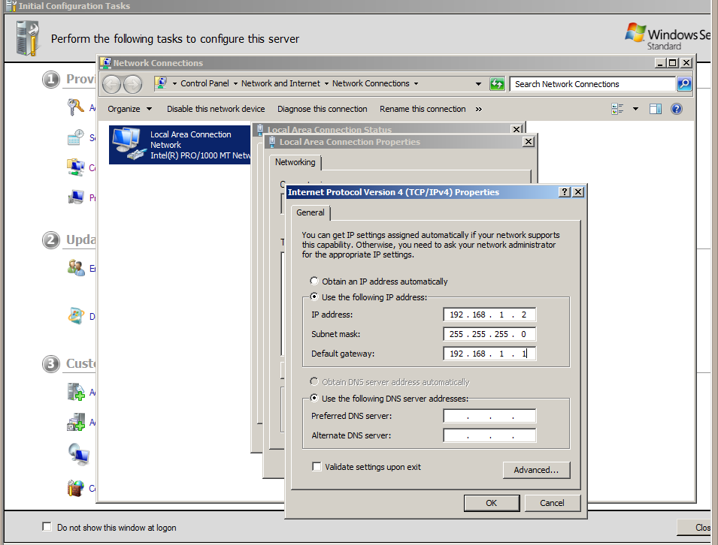
Give the Server a Static IP Address
Click Configure Networking then click on the connection. Go to Properties and then Internet Protocol Version 4 and type in your IP.

Slide 4
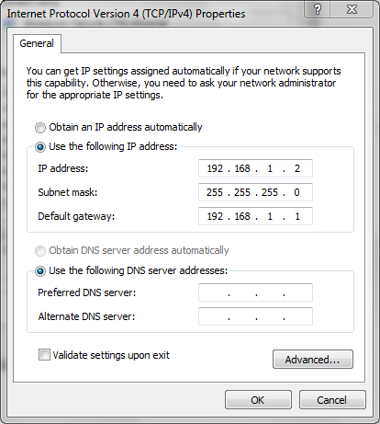
Connect Two Devices via Ethernet
After connecting the two laptops together via ethernet, go into the adapter setting of both the vm and the laptop and assign a static ip in the same subnet.

Slide 5
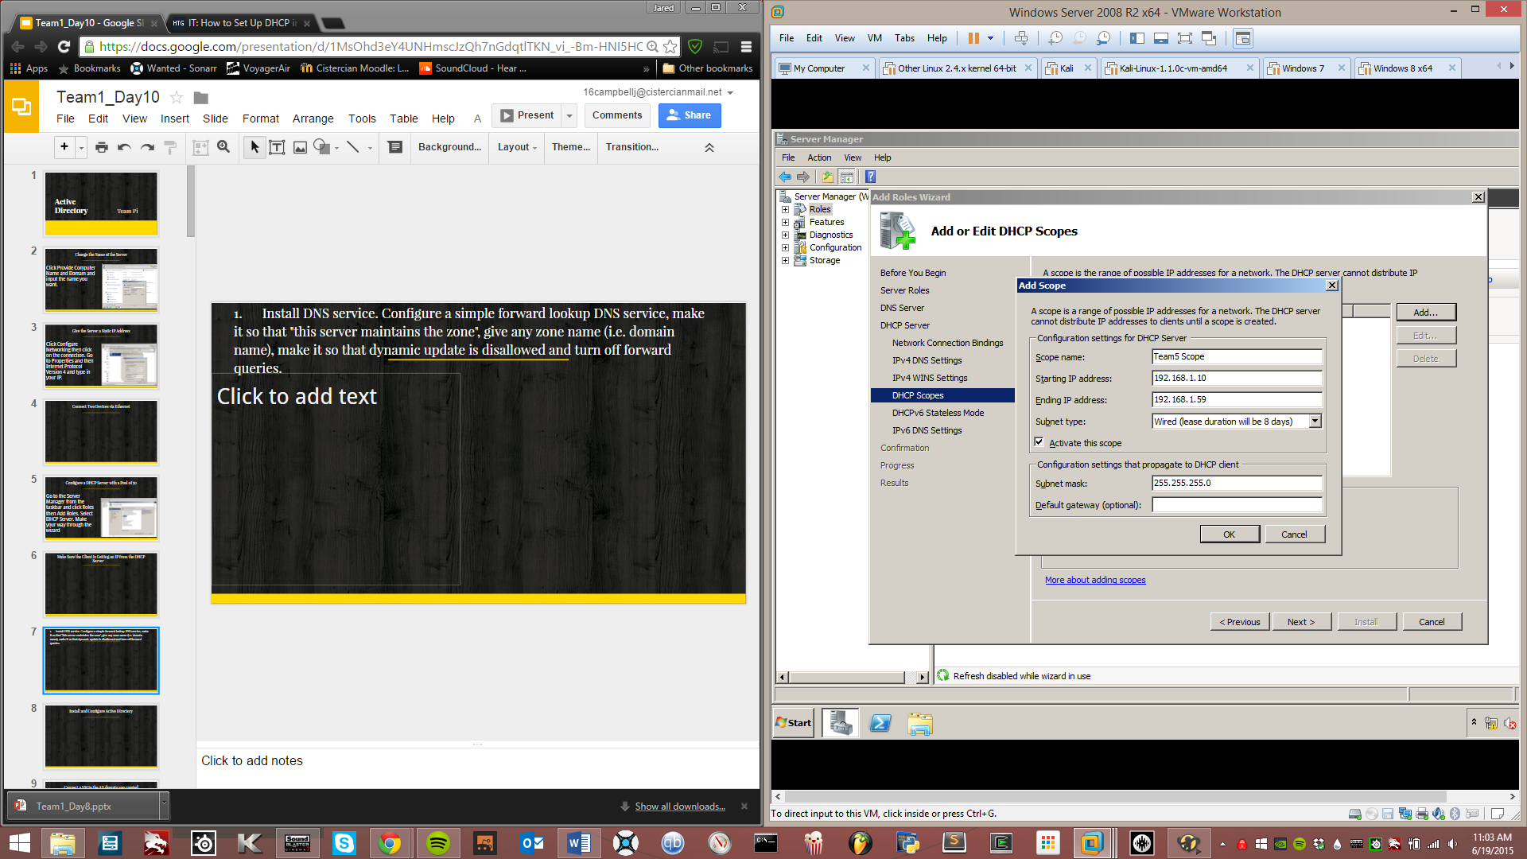
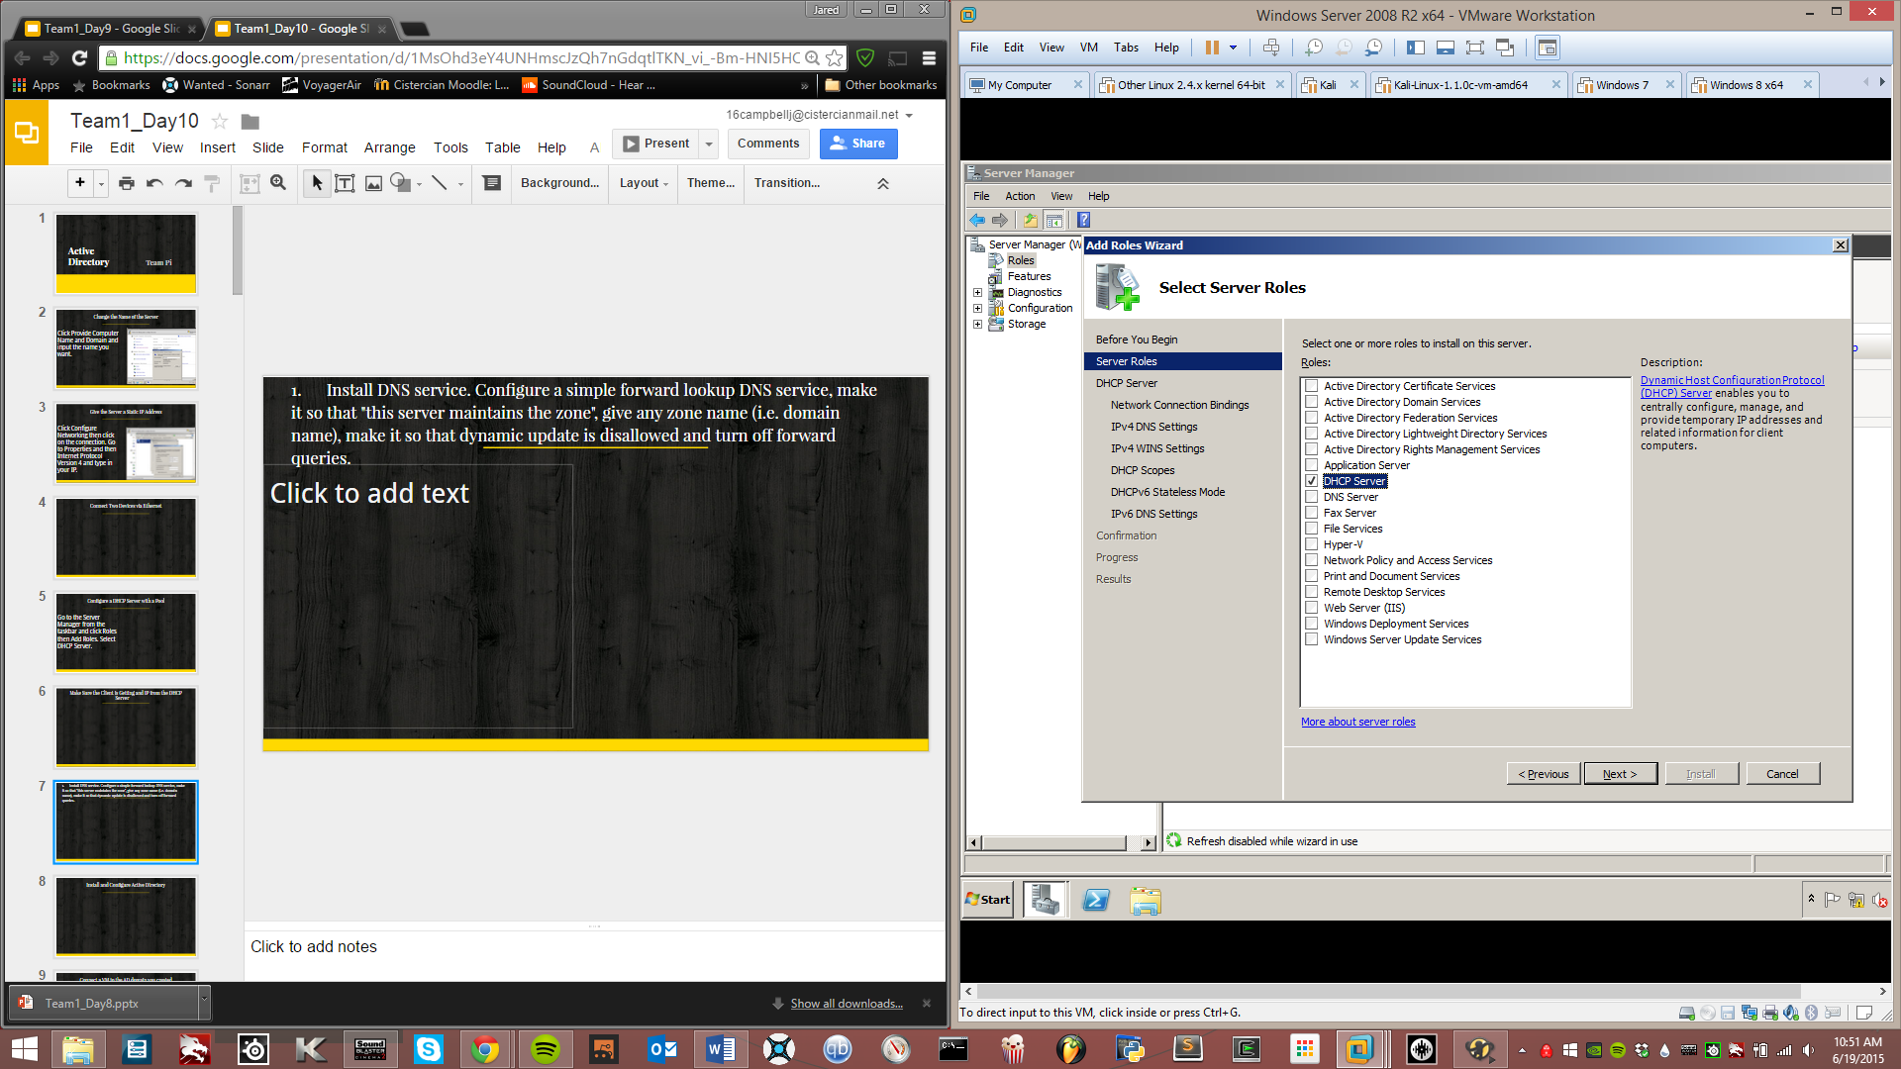
Configure a DHCP Server with a Pool of 50
Go to the Server Manager from the taskbar and click Roles then Add Roles. Select DHCP Server. Make your way through the wizard until you get to DHCP Scopes. Here click add and type in your IP address range so that it includes 50 IPs.

Slide 6
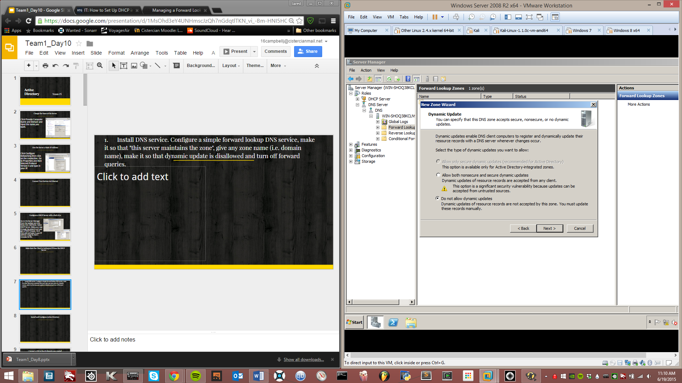
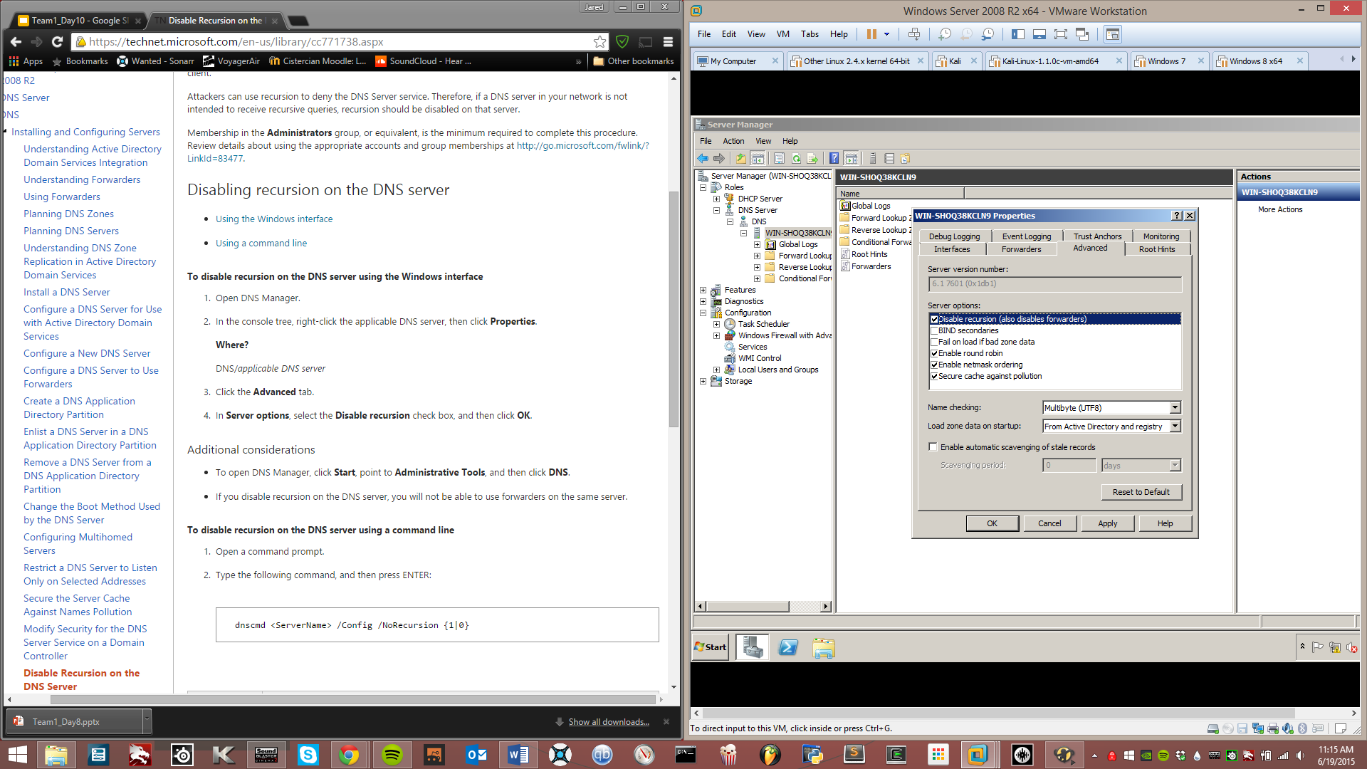
1. Install DNS service. Configure a simple forward lookup DNS service, make it so that "this server maintains the zone", give any zone name (i.e. domain name), make it so that dynamic update is disallowed and turn off forward queries.
Use the same method as installing DHCP. In the tree navigate to Forward Lookup Zones. Create a new one and make sure it is set to not allow dynamic updates. Click on the DNS Server and go to Properties then Advanced and make sure Disable recursion is checked.

Slide 7
Install and Configure Active Directory
Use the Add Roles Wizard just like last time.

Slide 8
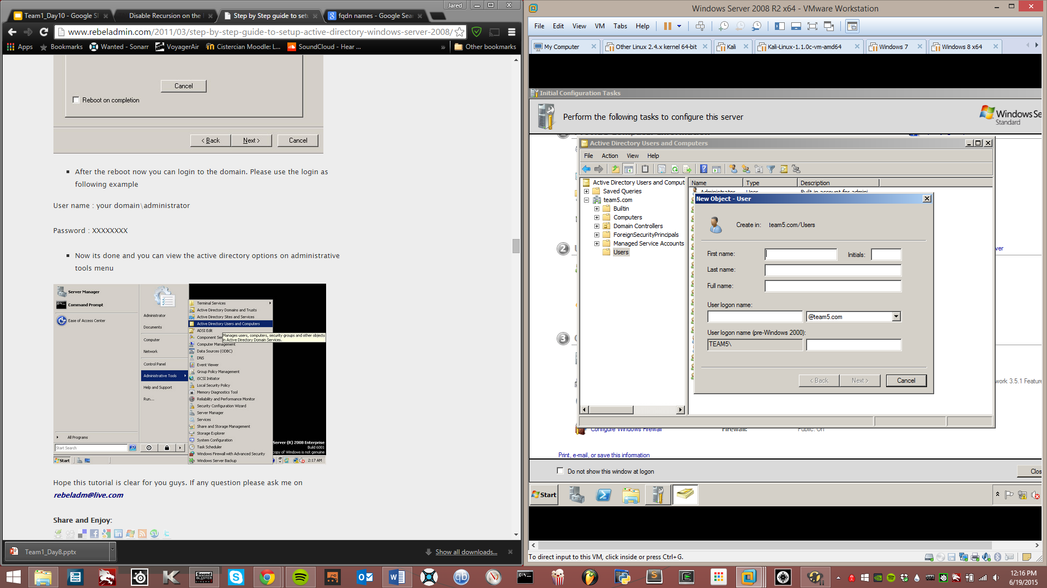
Create a User
Go to the Active Directory Users and Computers and navigate to Users. Click the Add Users button and fill in the info for your user

Slide 9
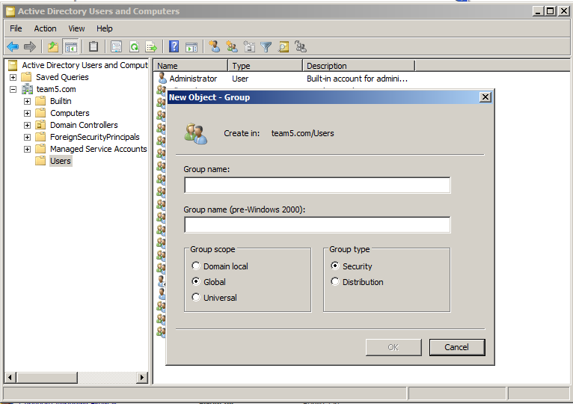
Create a Groups
Same thing, but click the Add Group button

Slide 10
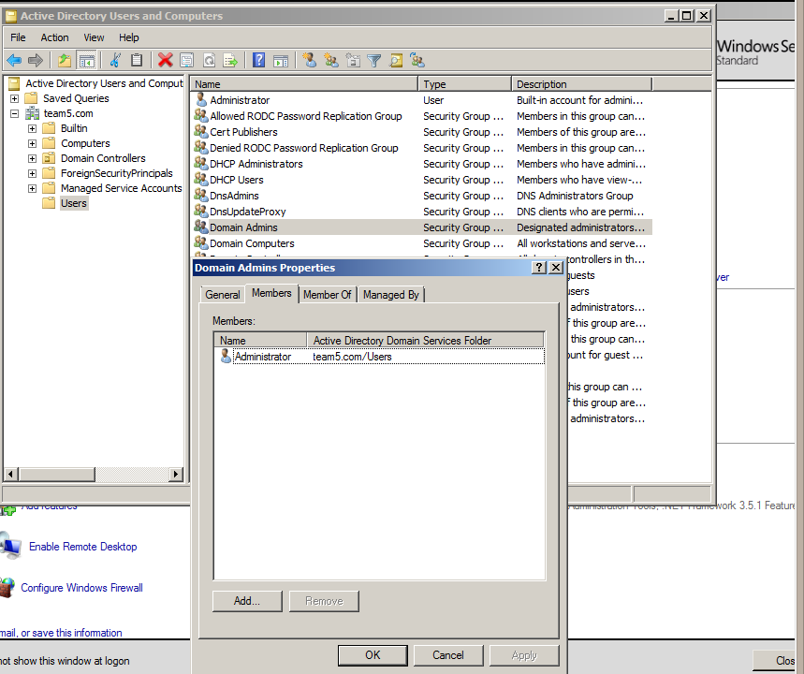
Add Users to Domain admin group and user group
Click on the group you want and go to Members then click Add

Slide 11
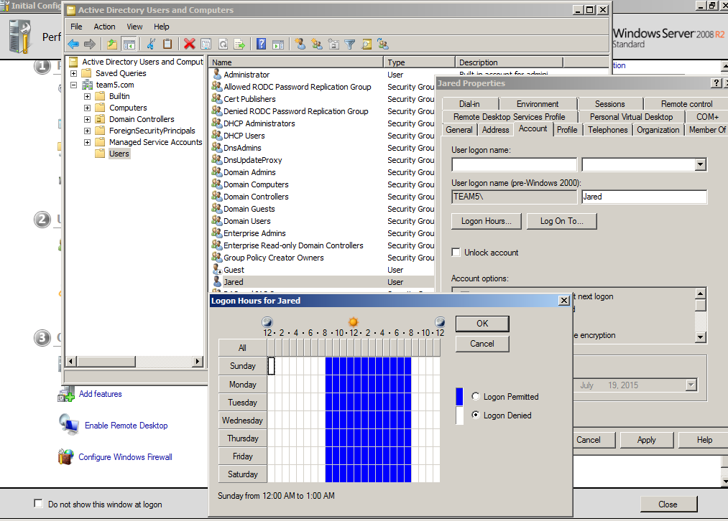
Make logon time for users from 8am to 8pm
Click the user you want to restrict and go to Properties then Account and click on Logon Hours.

Slide 12
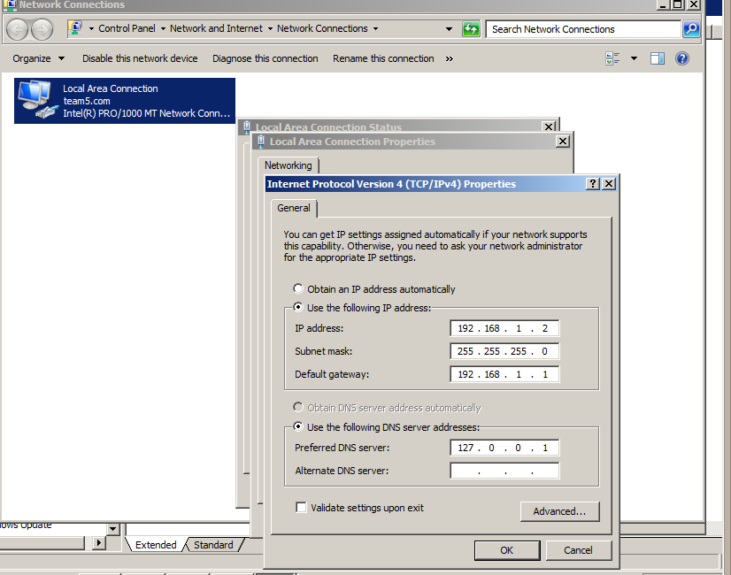
Configure Static IP Address
Open the Network and Sharing Center and go to Network connections. Click on your connection and go to properties then Internet Protocol Version 4 and input your address

Slide 13
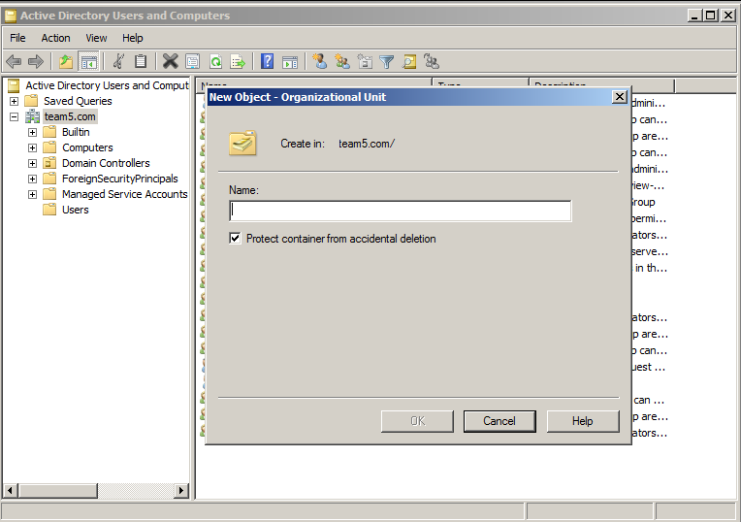
Create an Organizational Unit
Right-click the domain and choose new>Organizational Unit.

Slide 14
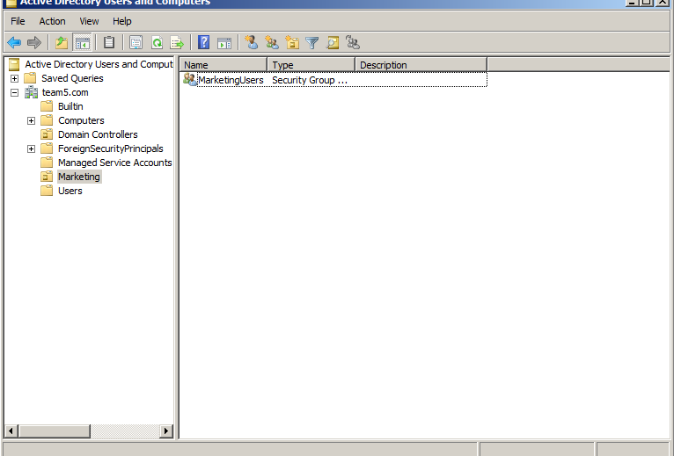
Add users to units
In Active Directory Users and Computers under your OU right click and select new>group. Then go to Users and select the users you want and right click and select add to new group

Slide 15
Group Policy Objects
Marketing OU

Slide 16
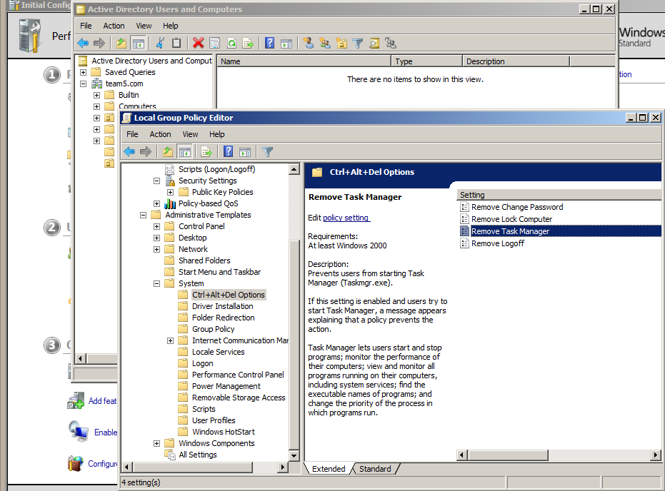
Disable Task Manager
In the Group Policy Editor navigate to User Configuration>Administrative Templates>Ctrl+Alt+Del Options

Slide 17
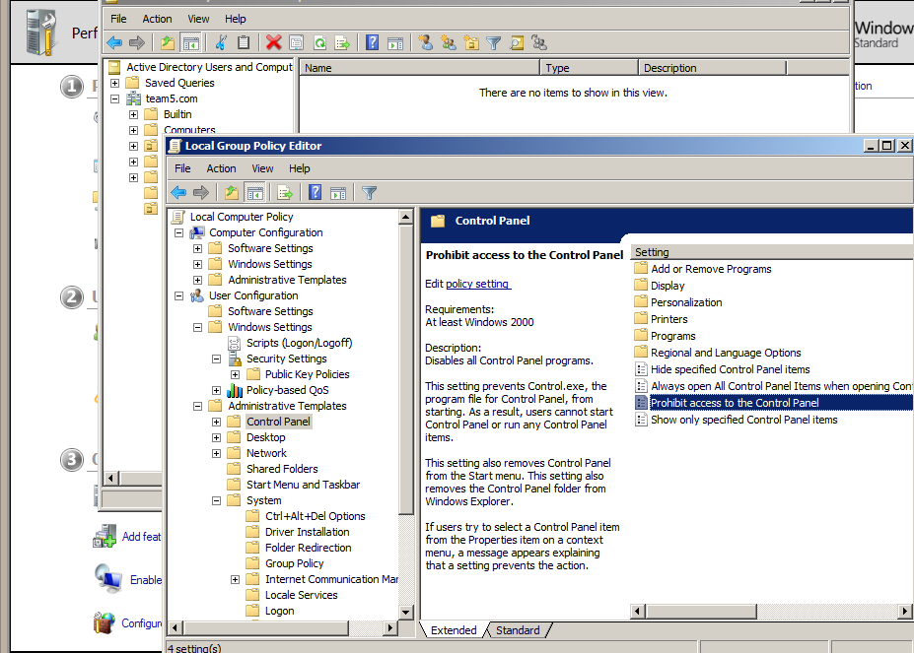
Prohibit access to control panel
Navigate to User Configuration>Administrative Templates>Control Panel

Slide 18
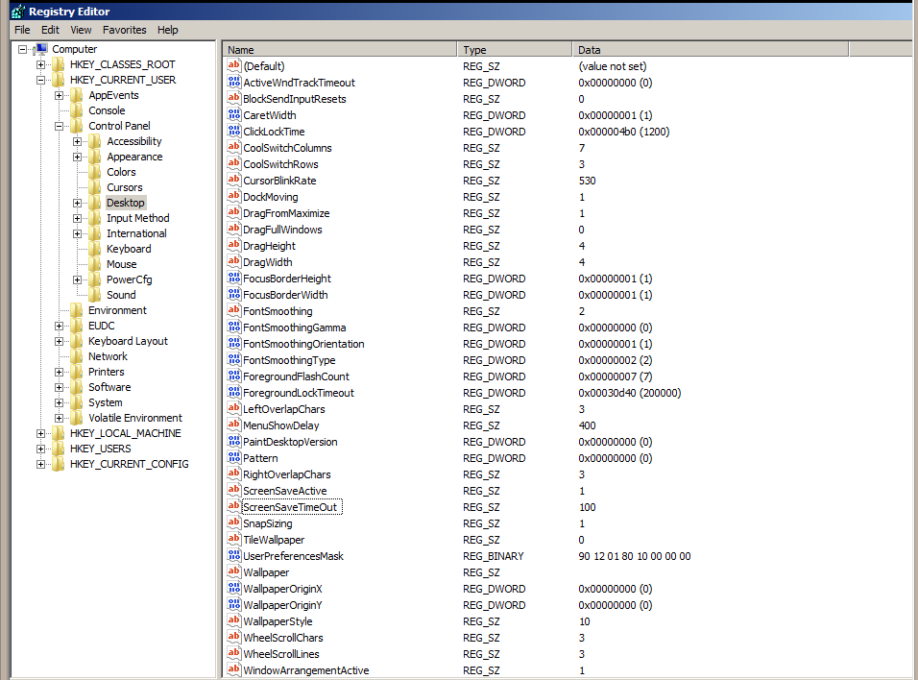
Set Screen Saver Timeout=100 seconds
In Regedit navigate to Hkey_Current_User>Control Panel>Desktop>ScreenSaverTimeOut and set the value to 100

Slide 19
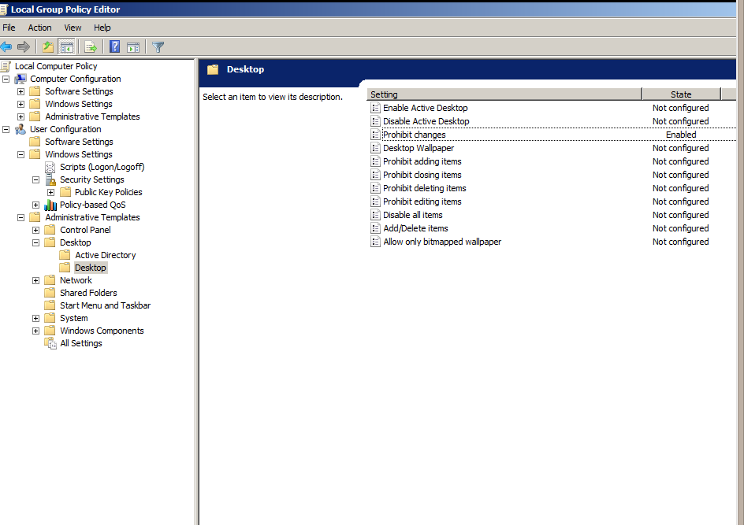
Prevent changing of desktop background
In the Group Policy Editor navigate to User Configuration>Administrative Templates>Desktop>Desktop and enable Prohibit Changes

Slide 20
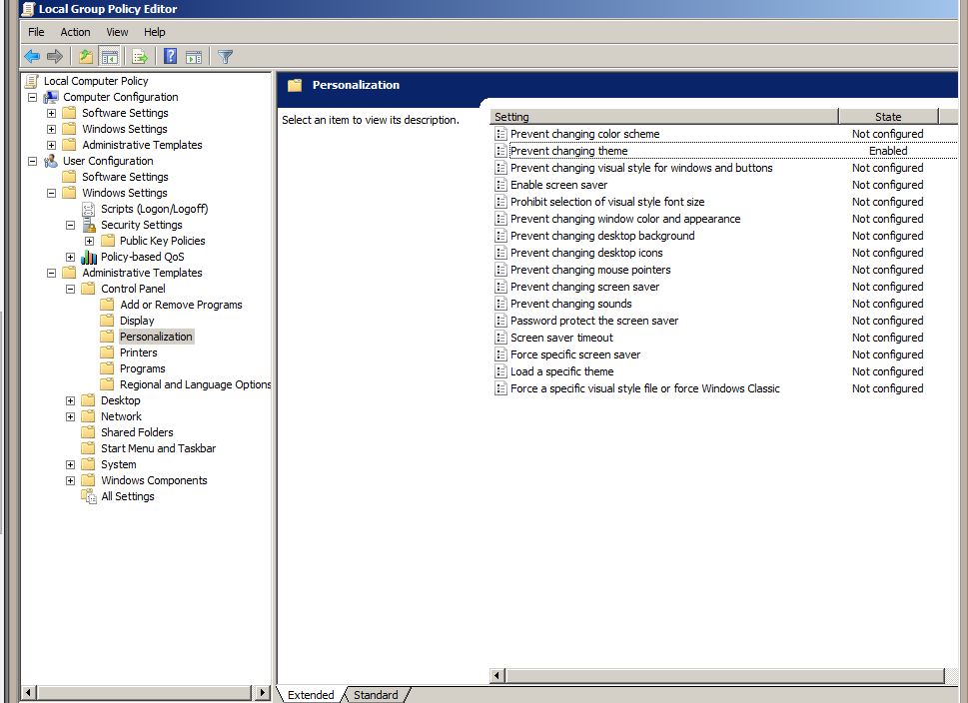
Prevent changing theme
In the Group Policy Editor navigate to User Configuration>Administrative Templates>Control Panel>Personalization and enable Prevent Changing Theme

Slide 21
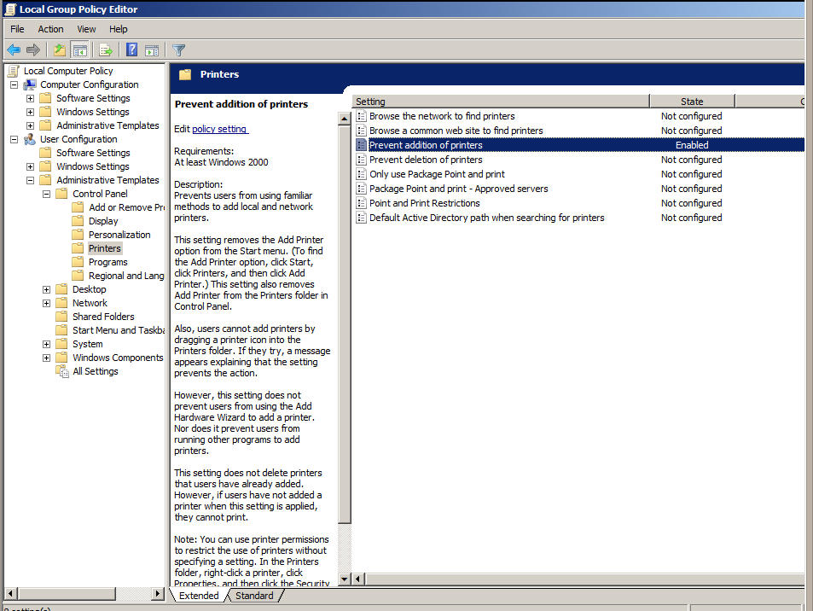
Prevent addition of printers
In the Group Policy Editor navigate to User Configuration>Administrative Templates>Control Panel>Printers and enable Prevent addition of printers.

Slide 22
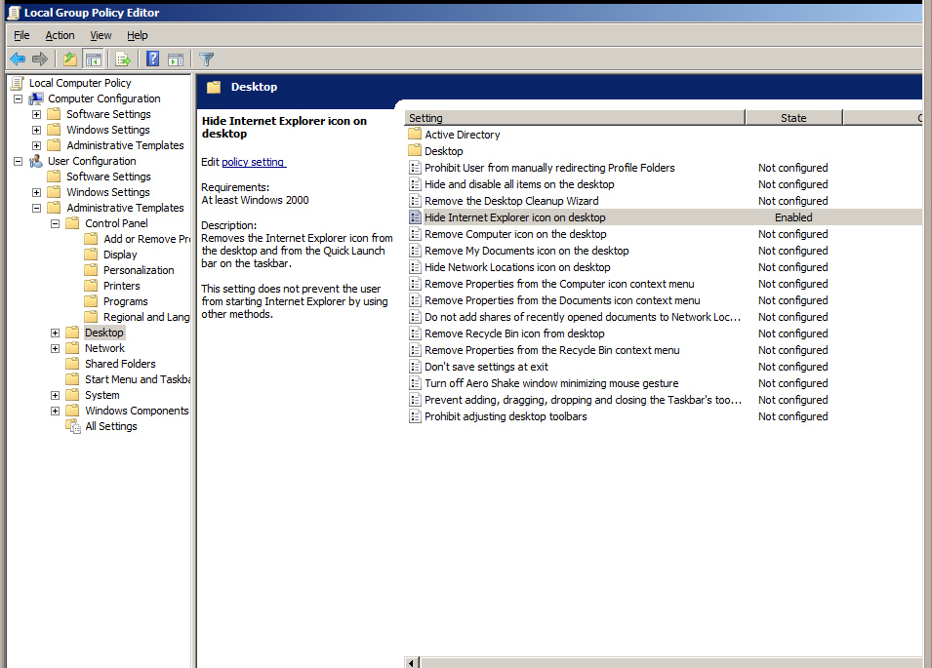
Hide IE icon on desktop
In the Group Policy Editor navigate to User Configuration>Administrative Templates>Desktop and enable Hide IE icon on desktop

Slide 23
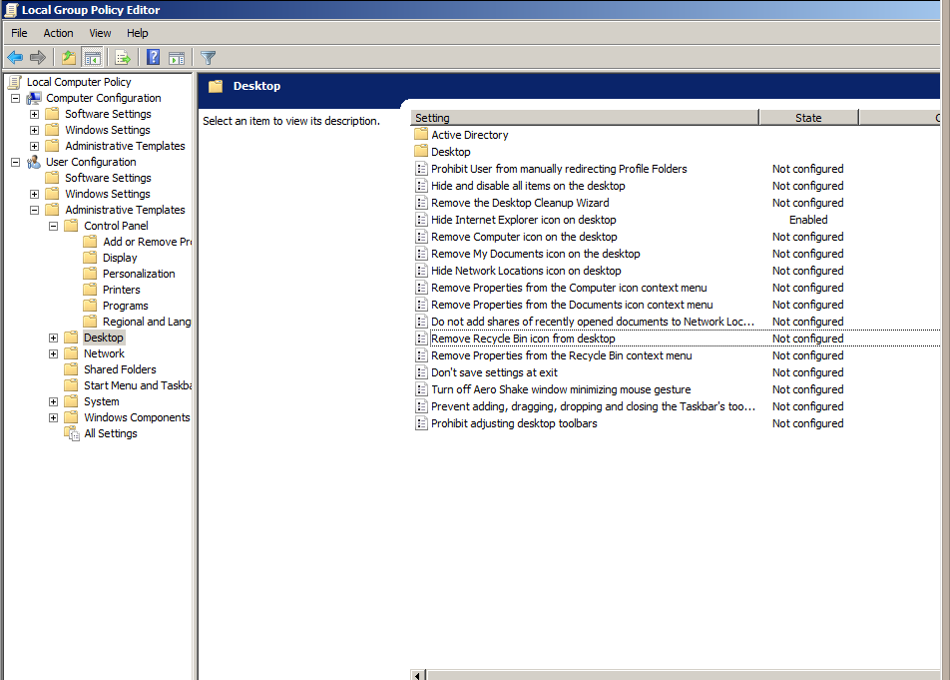
Remove recycle bin
In the Group Policy Editor navigate to User Configuration>Administrative Templates>Desktop and enable Remove Recycle Bin Icon from desktop

Slide 24
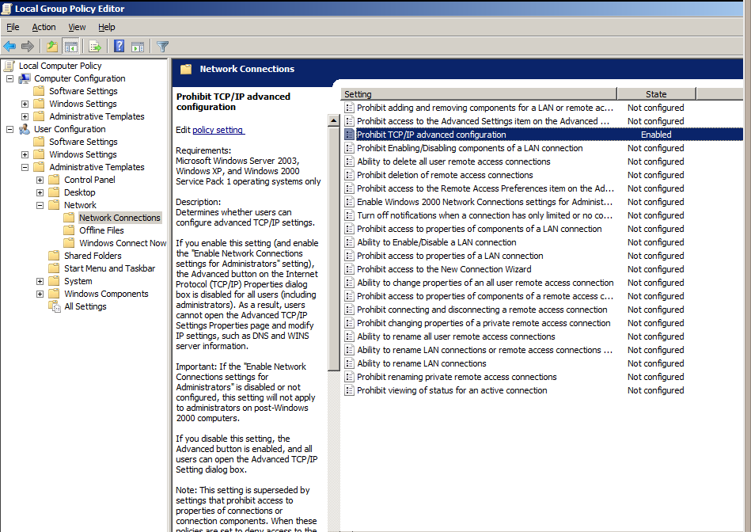
Prohibit access to TCP/IP advanced configurations
In the Group Policy Editor navigate to User Configuration>Administrative Templates>Network>Network Connections and enable Prohibit TCP/IP advanced configurations

Slide 25
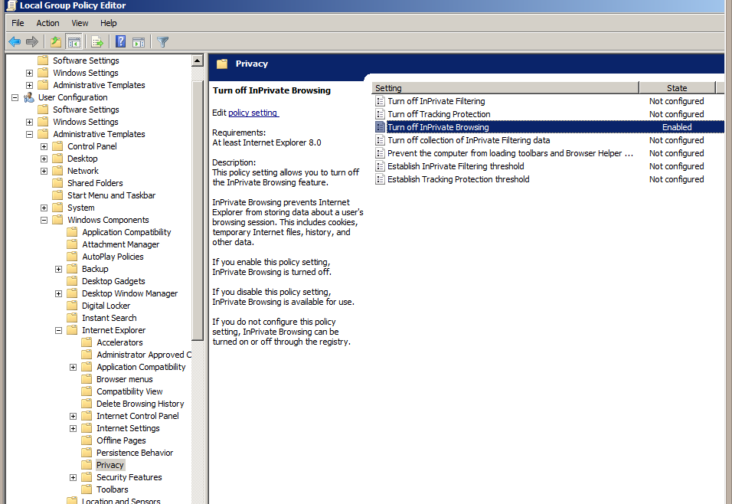
Turn off InPrivate browsing
In the Group Policy Editor navigate to User Configuration>Administrative Templates>Windows Components>Internet Explorer>Privacy and enable Turn off InPrivate Browsing

Slide 26
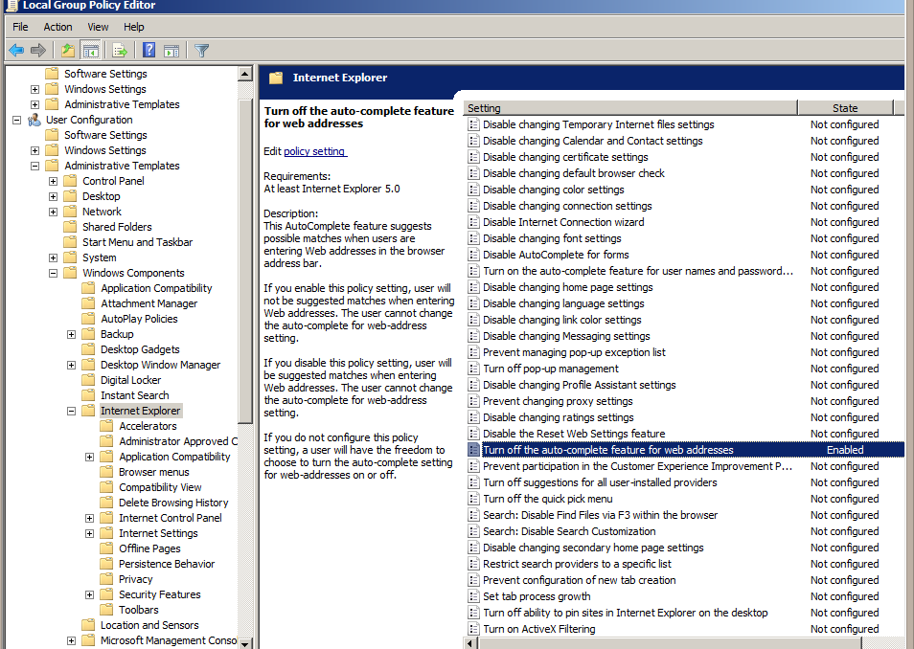
Turn off url suggestions
In the Group Policy Editor navigate to User Configuration>Administrative Templates>Windows Components>Internet Explorer and enable Turn off the auto-complete feature for web addresses

Slide 27
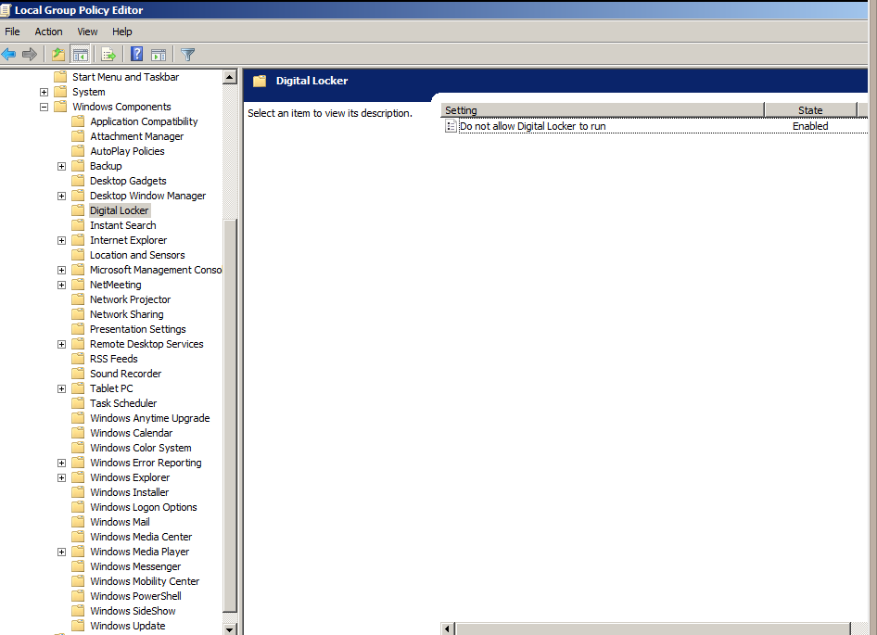
Do not allow digital locker to run
In the Group Policy Editor navigate to User Configuration>Administrative Templates>Windows Components>Digital Locker and enable Do not Allow Digital Locker to run

Slide 28
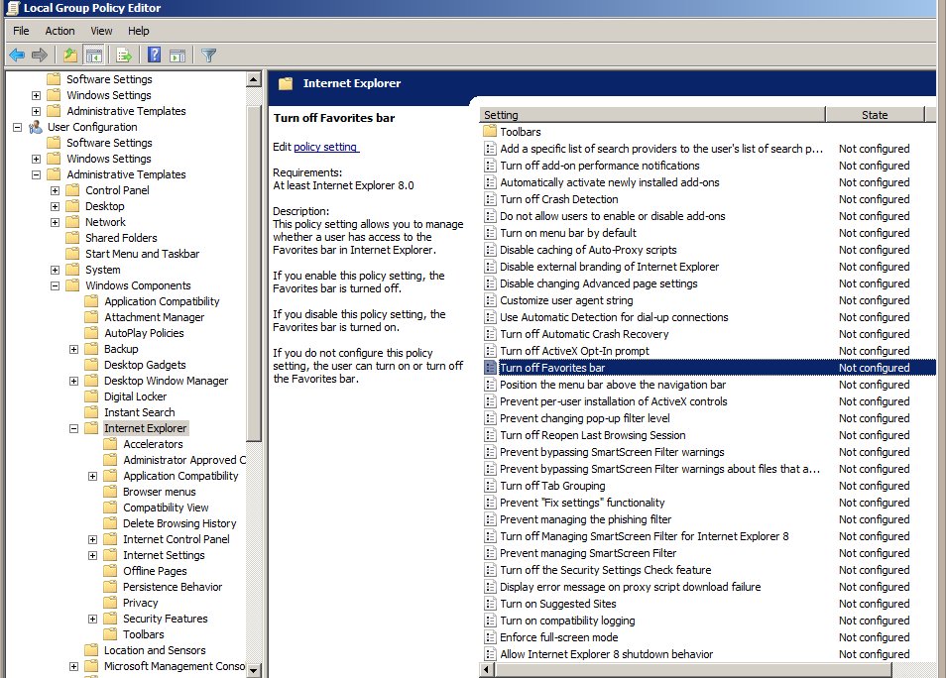
Turn off favorites bar
In the Group Policy Editor navigate to User Configuration>Administrative Templates>Windows Components>Internet Explorer and enable Turn off Favorites bar

Slide 29
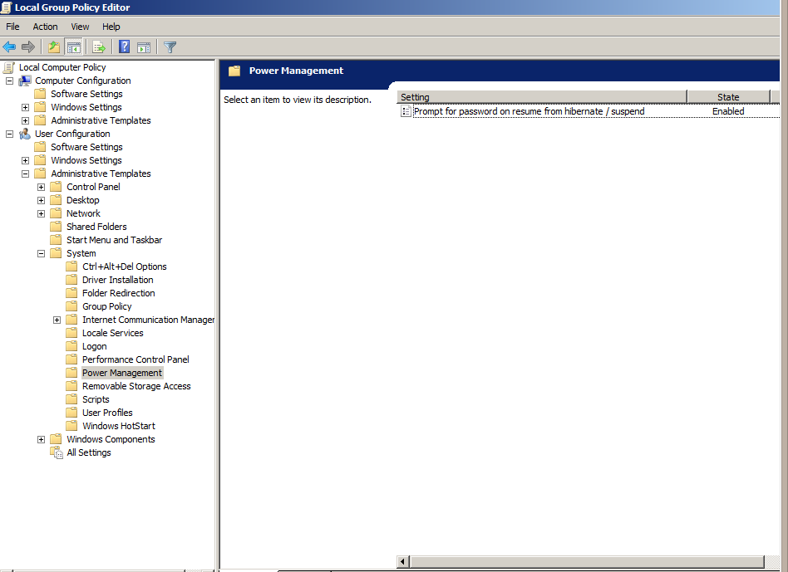
Prompt password on resume from hibernate/suspend
In the Group Policy Editor navigate to User Configuration>Administrative Templates>System>Power Management and enable Prompt for password on resume from hibernate/suspend

Slide 30
Group Policy Objects
Research OU

Slide 31
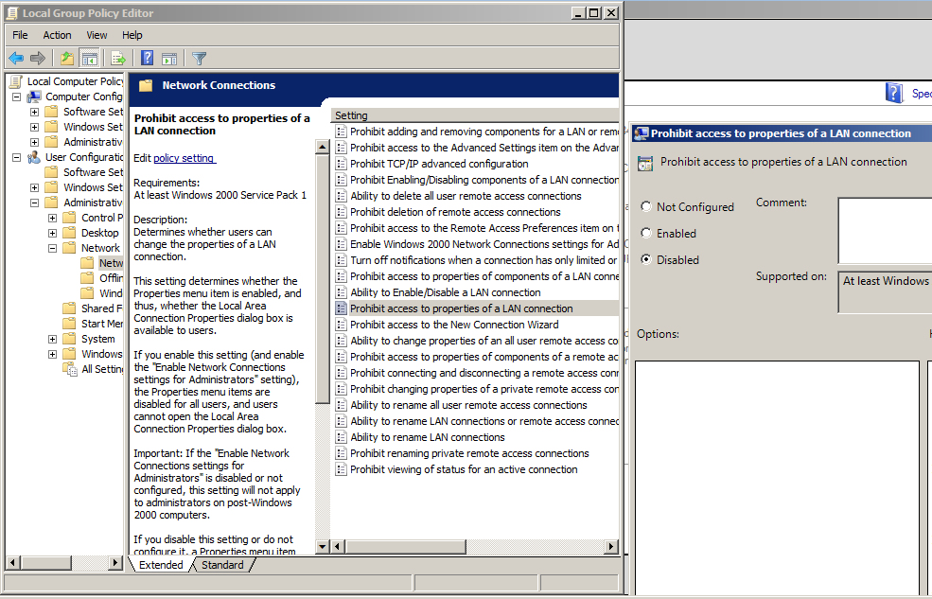
Prohibit access to LAN properties
Open group policy editor by typing in gpedit.msc in the start menu. Navigate to Administrative Templates\Network and Sharing Center\Network Connections Then Click ‘Prohibit access to…;’ and set ‘Enabled'

Slide 32
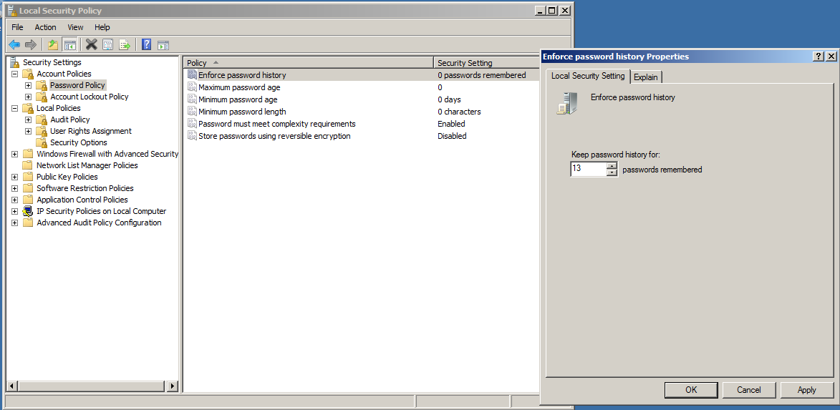
Enforce password history to 13 passwords
Type ‘secpol.msc’ in start menu, Go to Account Policies\Password Policy and set ‘Enforce pass…’ to
13.

Slide 33
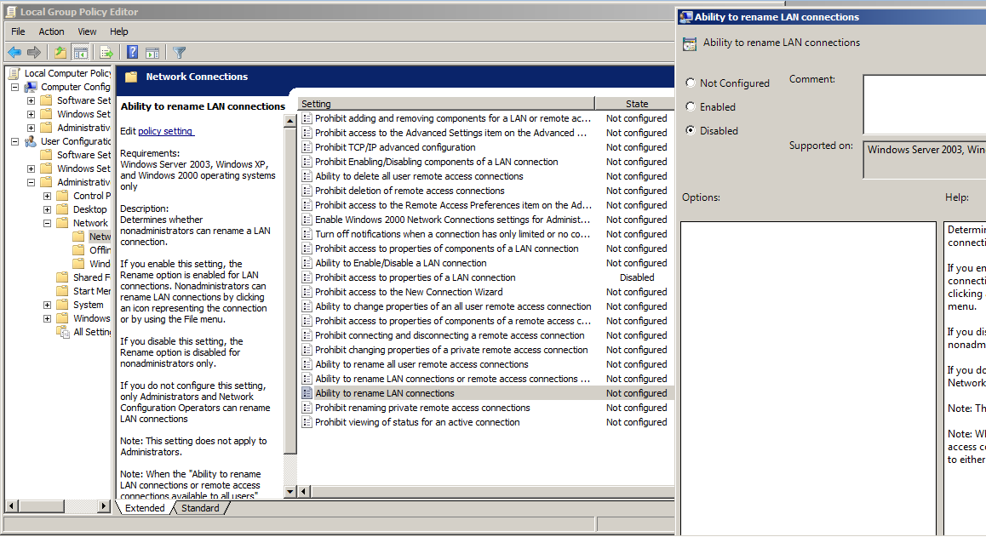
Prohibit renaming LAN connections
Navigate to the same place as the access, click on ‘Ability to rename LAN connections’ and set to disabled.

Slide 34
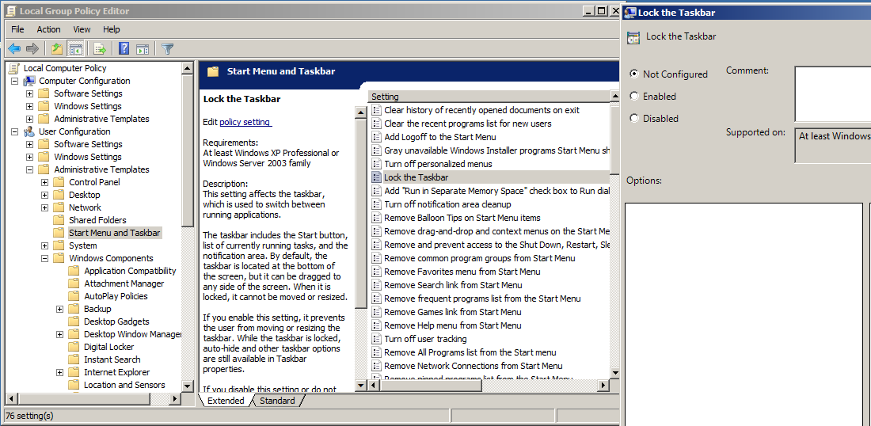
Lock Taskbar
In GPEditor go to User Configuration\Administrative Templates\Start Menu and Taskbar, enable ‘Lock the
Taskbar’.

Slide 35
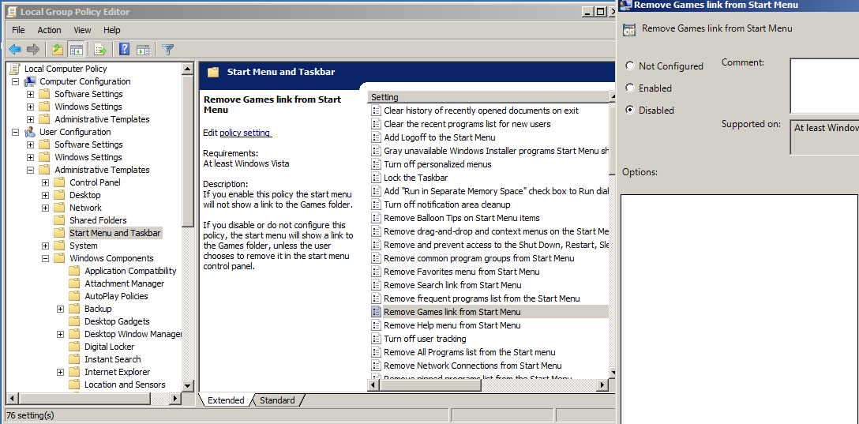
Remove games link from start menu
Navigate to User Configuration\Administrative Templates\Start Menu and Taskbar, enable ‘Remove
Games Link from
\ Start Menu.’

Slide 36
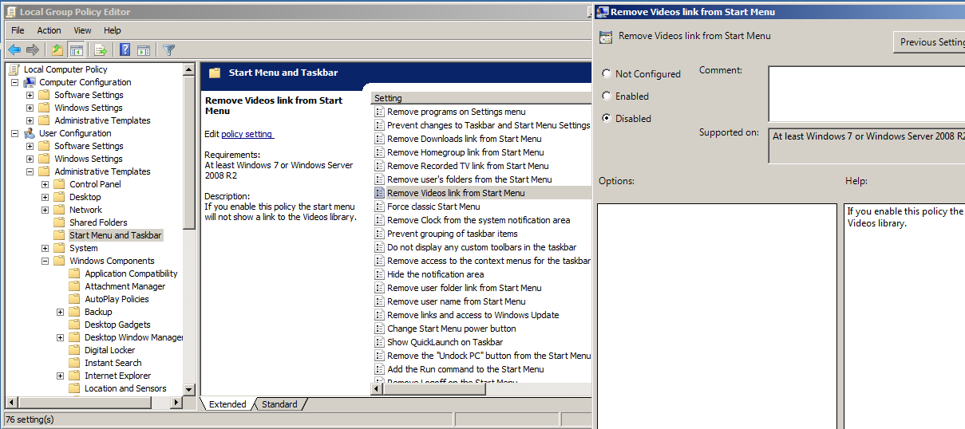
Remove video link from start menu
Navigate to User Configuration\Administrative Templates\Start Menu and Taskbar, enable ‘Remove
Games
link
from
Start
Menu’
.’

Slide 37
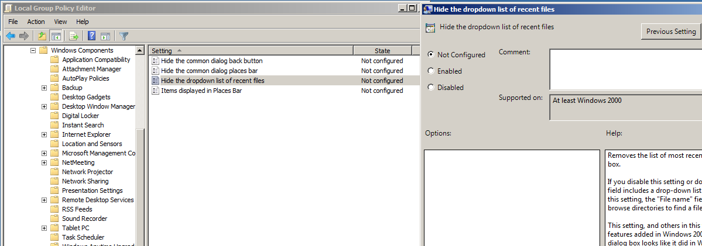
Hide dropdown list of recent files
User Configuration\Administrative Templates\Windows Components\Windows Explorer\Common Open File Dialog
Enable ‘Hide the dropdown list of recent files.

Slide 38
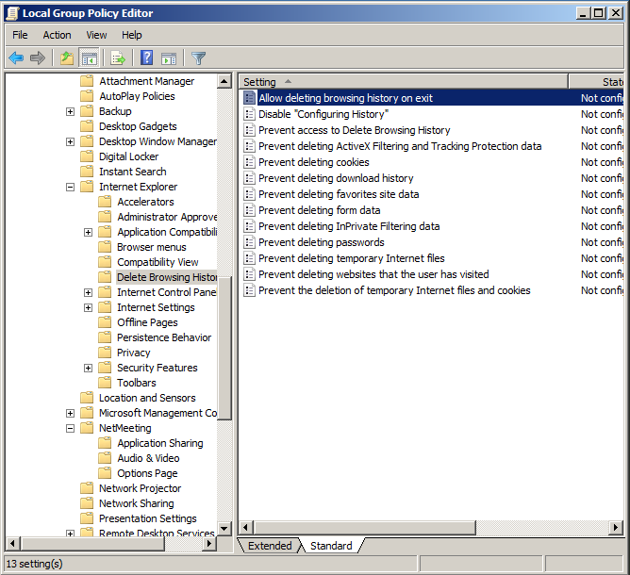
Prevent deleting temporary files
Windows Components\Internet Explorer\Delete Browsing History
Disable ‘Allow deleting...’

Slide 39
Allow ability to rename LAN connections
Same as blocking, but allow it now.

Slide 40
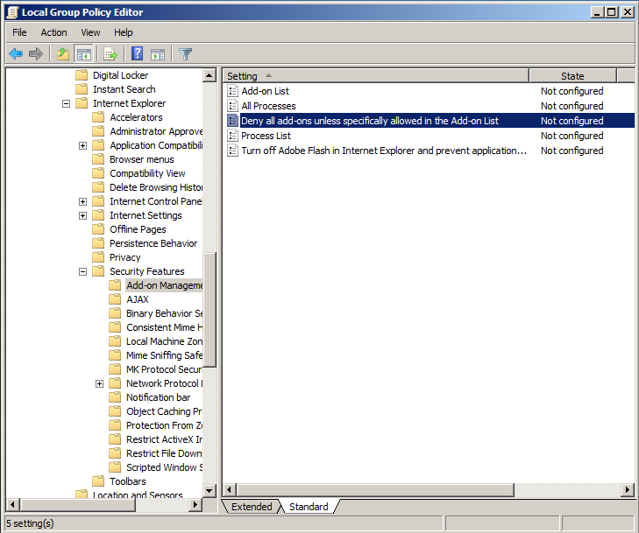
Deny add-ons unless specified
Go to Windows Components\Internet Explorer\Security Features\Add-on Management. Set ‘Deny all add-ons...’ to enabled

Slide 41
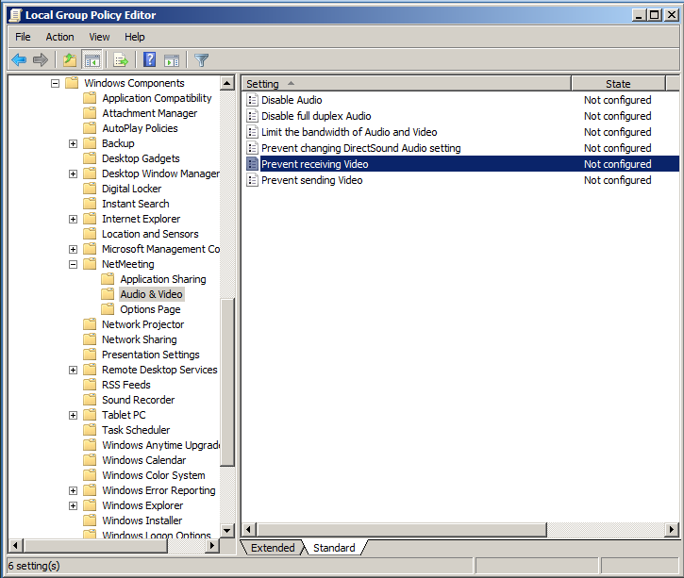
Prevent sending and receiving videos
Navigate to Windows Components\NetMeeting\Audio & Video and turn ‘Prevent video...’ for both sending and revieving.

Slide 42
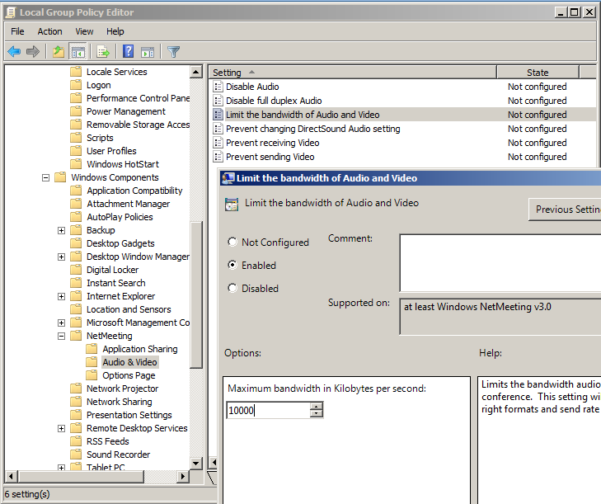
Limit bandwidth of audio and video to 10,000 kB
Go to Windows Components\NetMeeting\Audio & Video click on ‘Limit the bandwidth...’, check enabled and set to 10,000.

Slide 43
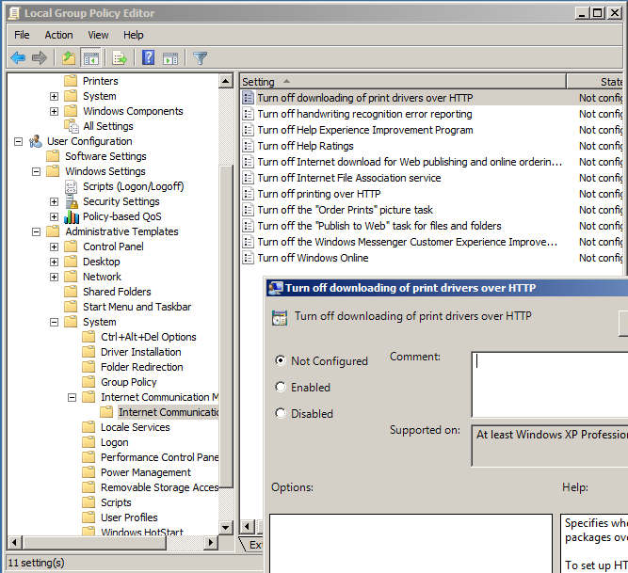
Turn off printing over HTTP
Go to System\Internet Communications Manager\Internet Communications settings
Enable ‘Turn off download...’

Slide 44
Group Policy Objects
Worker OU

Slide 45
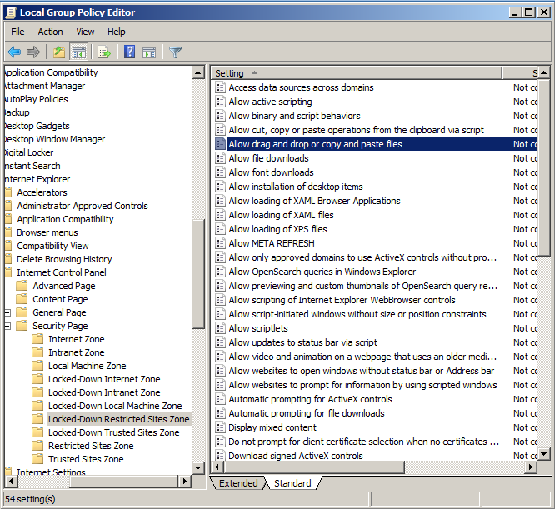
Disable drag drop and copy paste files
Windows Components\Internet Explorer\Internet Control Panel\Security Page\Locked-Down Restricted Sites Zone
Disable ‘Allow drag and...’

Slide 46
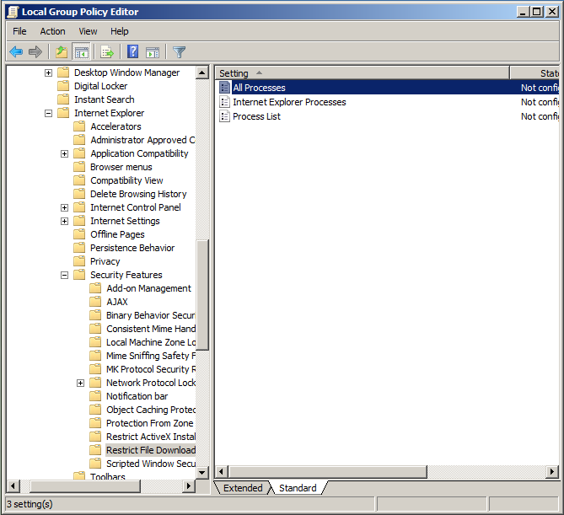
Disallow file download
Windows Components\Internet Explorer\Security Features\Restrict File Download
Disable ‘All Processes’

Slide 47
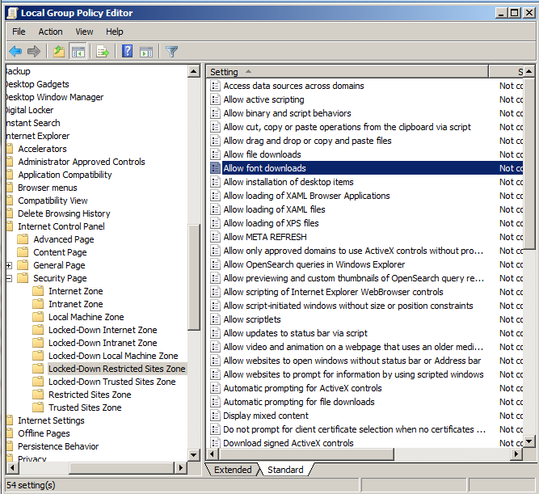
Disallow font downloads
Windows Components\Internet Explorer\Internet Control Panel\Security Page\Locked-Down Restricted Sites Zone
Disable ‘Allow font...’

Slide 48
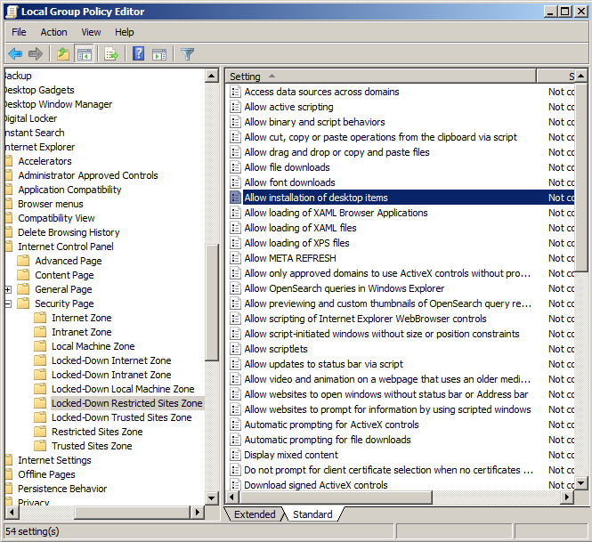
Disallow installation of desktop items
Windows Components\Internet Explorer\Internet Control Panel\Security Page\Locked-Down Restricted Sites Zone
Disable ‘Allow installation...’

Slide 49
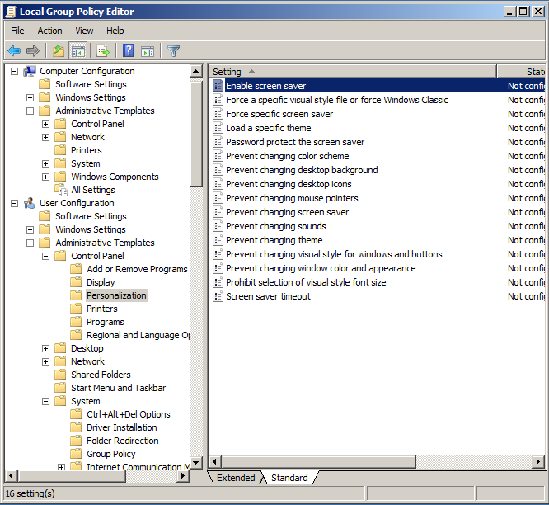
Disallow screen saver
Control Panel\Personalization
Disable ‘Enable screensaver’

Slide 50
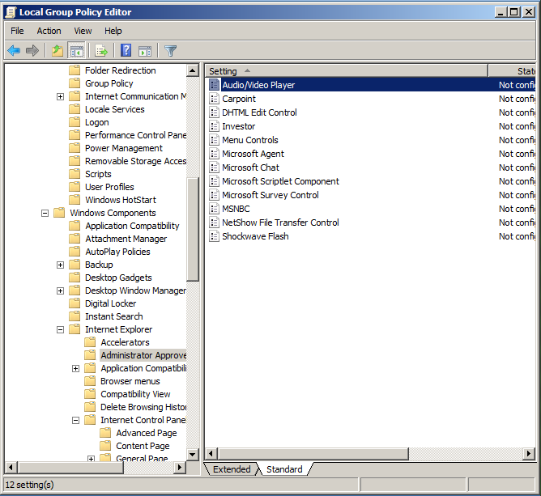
Disable audio/video player
Windows Components\Internet Explorer\Administrator Approved Controls
Disable ‘Audio/Video Player’

Slide 51
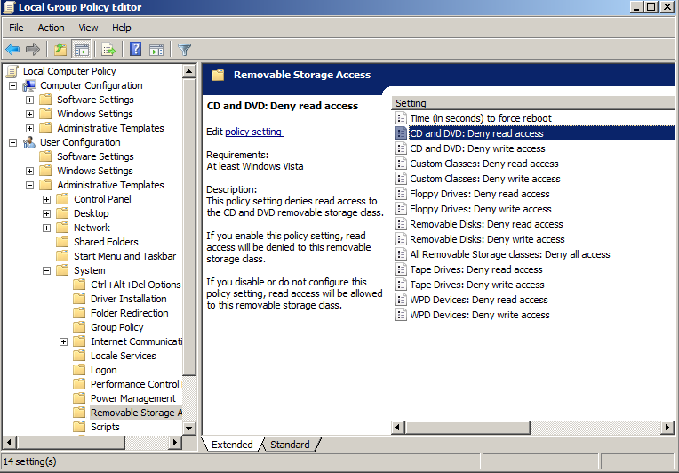
Deny DVD/CD read write access
System\Removable Storage Access

Slide 52
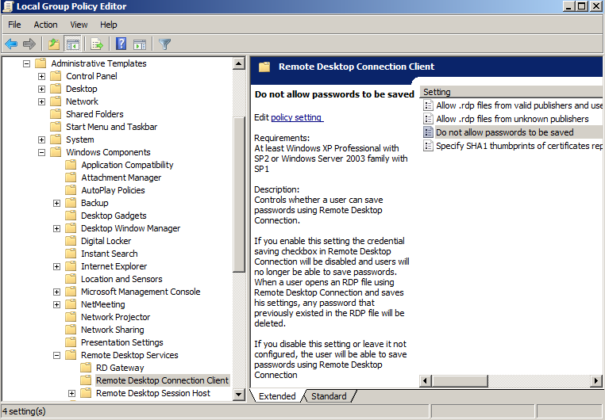
Do not allow passwords to be saved
Windows Components\ Remote Desktop Services\Remote Desktop Connection Client

Slide 53
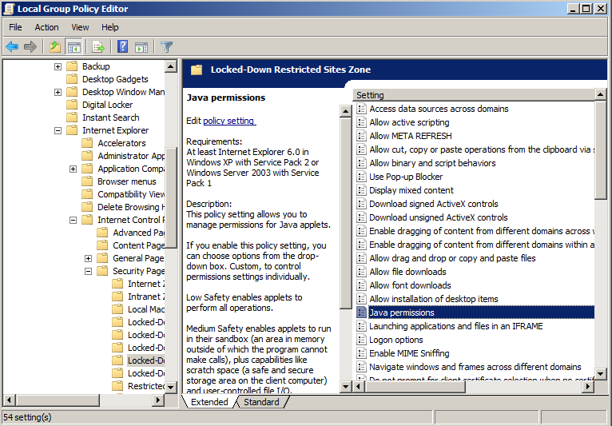
Disable java permissions
Windows Components\ Internet Explorer\ Internet Control Panel\ Security Page\ Locked-Down Restricted Sites Zone

Slide 54
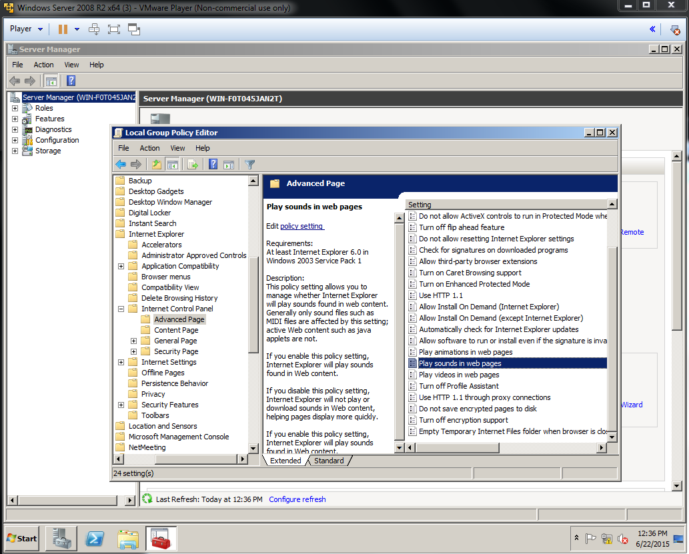
Disable playing audio and video on webpages
Windows Components\ Internet Explorer\ Internet Control Panel\ Advanced Page

Slide 55

Prevent access to registry editing tool
Found Directly in the System path.

Slide 56

Disable add and remove programs feature
Administrative Templates\Control Panel\Add/Remove Programs
Enable ‘Remove Add...’

Slide 57

Prohibit new task creation in task scheduler
Windows Components\Task Scheduler
Enable ‘Prohibit New...’

Slide 58

Prevent deleting cookies
Windows Components\Internet Explorer\Delete Browsing History
Enable ‘Prevent cookies...’

Slide 59

Prevent deleting download history
In the Group Policy Editor navigate to User Configuration>Administrative Templates>Windows Components>Internet Explorer>Delete Browser History and enable Prevent deleting download history

Slide 60

Prevent ability to enable/disable LAN connections
In the Group Policy Editor navigate to User Configuration>Administrative Templates>Network>Network Connections and enable Ability to Enable/Disable a LAN connection

Slide 61

Turn off autoplay
In the Group Policy Editor navigate to User Configuration>Administrative Templates>Windows Components>AutoPlay Policies and enable Turn off Autoplay

Slide 62

Turn off browser geolocation
In the Group Policy Editor navigate to User Configuration>Administrative Templates>Windows Components>Internet Explorer and enable Turn off browser geolocation

Slide 63

Do not display reveal password button
In the Group Policy Editor navigate to User Configuration>Administrative Templates>Windows Components>Internet Explorer>Security Features and enable Do not display the reveal password button

Slide 64
Pass the Hash
Pass the hash works by taking hashed versions of credentials stored on your computer and using them to gain administrator access.
To stop these attacks, stop your machine from caching them.

Slide 65
Resources
https://www.vanstechelman.eu/windows-group-policy-encyclopedia/c99d9d067974ea349b2f93a90ff38477/allow-drag-and-drop-or-copy-and-paste-files
http://www.techrepublic.com/blog/the-enterprise-cloud/prevent-users-from-disabling-network-connections-in-windows-server-2008/
https://support.microsoft.com/en-us/kb/967715

